Slide 1

MARKETING CAMPAIGN ANALYSIS
Customer segmentation to optimize marketing efforts
Capstone Project · Presented by Ashton Merrick
Notes:
• Good morning. I'm Ashton Merrick. This capstone segments a company's 2,240 customers so marketing spend can be targeted instead of broadcast.
• I'll cover the problem, the approach, what was found, the proposed model, the four segments, the business solutions, and how to execute them.

Slide 2


Problem definition
Problem to solve
Marketing time, money, and other critical resources are limited
Create a clustering methodology that segments the customer base, so the marketing team can optimize its efforts and provide a tailored, more personalized experience for its customers.
What do the different segments of customers look like?
What efforts will each segment likely respond to or engage with?
Segmentation targets different groups of customers to drive engagement and higher conversion rates
Better-targeted efforts strengthen marketing ROI
The nature of the problem
No customer comes with a "correct" segment label.
Groups have to be discovered from purchasing behavior, then judged on how distinct and how actionable they are.
2

Slide 3




Our approach: from data to segments
1
2
3
4
Understand the data
Prepare it
Find natural groupings
Profile and act
2,240 customers and 27 attributes: demographics, spending over the last 2 years in 6 product categories, purchase channels and web activity, and the outcomes of 6 campaigns plus complaints.
Fix errors and gaps (outliers, 24 missing incomes, 3 implausible birth years) and build the measures the business thinks in: total spend, tenure, family size, amount per purchase.
25 behavioral measures standardized and clustered with five different methods, all compared on one yardstick.
Describe each group in plain business terms, using the demographics held back for profiling, and decide what to do with it.
Segmentation attributes versus profiling attributes: behavior (income, spending, channels, campaign responses) defines the segments; demographics (age, dependents, education, marital status) describe them afterwards
3

Slide 4


Our approach: five methods, one yardstick
1
2
3
4
5
K-Means
K-Medoids
Hierarchical
DBSCAN
Gaussian Mixture
Groups customers around the center of each segment.
Like K-Means, but each center is a real customer, so unusual customers distort it less.
Builds a tree of similar customers and cuts it into segments.
Finds dense groups of similar customers and flags outliers that fit nowhere.
Gives every customer a probability of belonging to each segment.
One yardstick: the silhouette score
Then: are the segments actionable?
A separation score from -1 to 1: how similar each customer is to their own segment versus the nearest other segment. Higher means tighter, better-separated segments. Every method is scored on the same standardized data, so the comparison is like-for-like.
The best score is not automatically the best answer for marketing. A solution also has to produce segments that are large enough to matter, distinct in behavior, and translatable into a treatment the team can run.
4

Slide 5



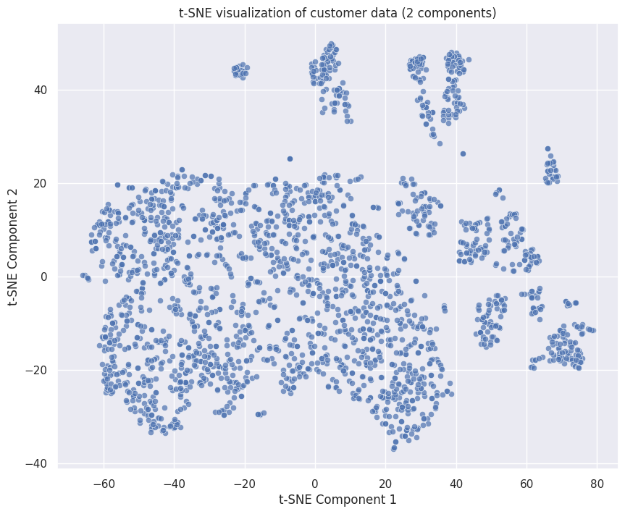
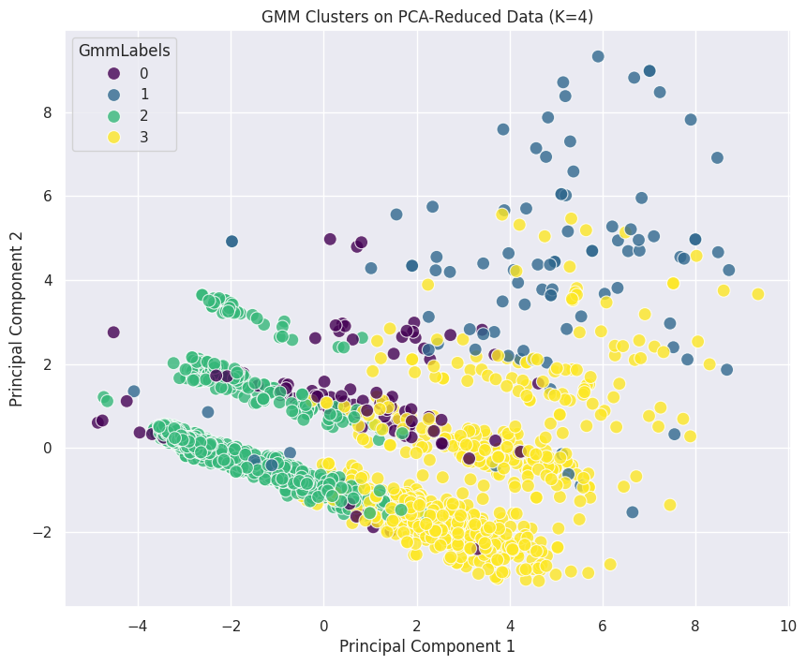
What was found
Customers form distinct groupings
The strongest split is simply high vs low value
A t-SNE projection shows several distinct, well-separated groupings, so segmentation is viable rather than forced.
Two clusters score best on separation (0.308), but two groups only re-state "high spenders vs low spenders" — too coarse to act on.
The GMM is the best 4-segment solution
Two small segments hold most of the campaign response
Separation 0.305 vs 0.205 for hierarchical clustering — nearly matching the 2-cluster optimum with twice the granularity.
Just 4.3% and 5.0% of customers, yet they accept the most offers — where targeted spend pays.
t-SNE projection of the 25 standardized behavioral features: distinct groupings.
The four GMM segments projected onto two principal components.
5
Notes:
• First, customers form distinct groupings: the t-SNE projection on the left shows several well-separated groupings before any clustering, so segmentation is viable rather than forced.
• Second, the strongest split is simply high versus low value: two clusters score best at 0.308, but two groups only re-state high spenders versus low spenders — too coarse to act on.
• Third, the Gaussian Mixture Model is the best four-segment solution: 0.305 versus 0.205 for hierarchical clustering, nearly the two-cluster optimum with twice the granularity. Its four segments are the plot on the right.
• Fourth, two small segments hold most of the campaign response: just 4.3 and 5.0 percent of customers, yet they accept the most offers — that is where targeted spend pays.

Slide 6
Proposed model: Gaussian Mixture Model with four segments
Best separation among 4-segment solutions
How the five approaches compared
Silhouette 0.305 on hard assignments — versus 0.205 for hierarchical clustering, and nearly the 0.308 of the coarse 2-cluster optimum.
Approach | Segments | Score | Note
K-Means | 2 | 0.308 | Highest, but coarse
K-Medoids | 2 | 0.242 | Balanced; weaker
Hierarchical | 4 | 0.205 | Fallback option
Gaussian Mixture | 4 | 0.305 | Proposed model
DBSCAN | 3 + noise | 0.221 | 15% unassigned
A probability for every customer
Soft assignments: borderline customers can receive hybrid treatment, and within a segment campaign budget can be ordered by assignment confidence.
Stable and reproducible
Fit from 15 random starts; the adopted solution recurred across four seeds at the best likelihood, and any solution with a component under 50 customers was screened out as a known artifact.
Silhouette score on the standardized clustering features; DBSCAN scored on its clustered points, GMM on its most-probable assignments. Full table in the appendix.
4 segments
Fallback: hierarchical clustering (Ward linkage, 4 clusters) produced segments highly consistent with the GMM's and is the simpler, easier-to-communicate alternative — at the cost of weaker separation (0.205) and no assignment probabilities.
1,318 · 713 · 112 · 97 customers
6
Notes:
• Three reasons for the Gaussian Mixture Model. Best separation among four-segment solutions: 0.305, versus 0.205 for hierarchical clustering and nearly the 0.308 of the coarse two-cluster optimum.
• A probability for every customer: borderline customers can receive hybrid treatment, and campaign budget can be ordered by assignment confidence.
• Stable and reproducible: fit from 15 random starts, the adopted solution recurred across four seeds at the best likelihood; any solution with a component under 50 customers was screened out as a known artifact.
• The table is the full comparison — K-Means highest at 0.308 but coarse, K-Medoids 0.242, hierarchical 0.205 as the fallback, the Gaussian Mixture 0.305, DBSCAN 0.221 with 15 percent unassigned — giving four segments of 1,318, 713, 112, and 97 customers.

Slide 7



The four customer segments (segment averages)
58.8%
31.8%
5.0%
4.3%
Budget-Conscious Low Engagers
Affluent High Spenders
Deal-Driven Campaign-4 Responders
Elite Multi-Campaign Responders
1,318 customers
713 customers
112 customers
97 customers
Income about $39,400
Total spend about $200 (median $92)
10.6 purchases; 6.2 web visits/month
0.15 offers accepted; 1.23 dependents (most)
Youngest (age 45.9); nearly all Basic-education customers
Income about $71,400
Total spend about $1,242 (median $1,174)
21.7 purchases (most): 8.4 store, 5.5 catalog
3.6 web visits/month (fewest); 0.58 offers accepted
0.48 dependents; 0% accepted campaign 4
Income about $52,200; wine-tilted ($459 of $626)
3.5 deal purchases (most); 6.5 web visits (most)
76% accepted campaign 4
18% complaint rate — nearly all complainers
Oldest on average (age 51); 1.12 dependents
Income about $80,200 (highest)
Total spend about $1,426; $93 per purchase
2.85 offers accepted per customer
85% Cmp4 · 66% Cmp5 · 56% Cmp6 · 30% Cmp2
1.33 deal purchases (fewest); 0.39 dependents; 29% PhD (most)
7
Notes:
• Every figure here is a segment average. Budget-Conscious Low Engagers, 58.8 percent or 1,318 customers: income about 39,400; total spend about 200 dollars, median 92; 6.2 web visits a month but only 0.15 offers accepted; the most dependents and the youngest group.
• Affluent High Spenders, 31.8 percent or 713 customers: income about 71,400; total spend about 1,242; the most purchases at 21.7, led by store and catalog; the fewest web visits; 0.58 offers accepted, none for campaign 4.
• Deal-Driven Campaign-4 Responders, 5.0 percent or 112 customers: income about 52,200, spending tilted to wine; the most deal purchases and web visits; 76 percent accepted campaign 4; an 18 percent complaint rate — nearly all complainers.
• Elite Multi-Campaign Responders, 4.3 percent or 97 customers: the highest income at about 80,200; total spend about 1,426, 93 dollars per purchase; 2.85 offers accepted each — 85 percent on campaign 4, 66 on 5, 56 on 6; the fewest deal purchases and the most PhDs.

Slide 8
Proposed business solutions
Elite Multi-Campaign Responders (4.3%)
Prioritize for premium campaign launches, exclusive early access, loyalty/VIP programs, and personalized high-end recommendations. Cost of contact is trivial relative to their response propensity.
Affluent High Spenders (31.8%)
The revenue core. Cross-sell and up-sell premium products, brand-loyalty programs, quality-led messaging rather than discounts; their catalog and store usage suits high-touch channels.
Deal-Driven Campaign-4 Responders (5.0%)
Price-sensitive and reachable digitally: promotional offers, bundles, clearly communicated discounts via email and web; replicate what worked in campaign 4. Their complaint history makes service recovery and satisfaction monitoring worthwhile.
Budget-Conscious Low Engagers (58.8%)
Broad campaigns are likely wasted. Value-focused marketing: affordability messaging, family-sized options, essential-product bundles through digital, deal-led touchpoints — run as small test-and-learn offers with modest conversion expectations.
8
Notes:
• Elite Multi-Campaign Responders: premium campaign launches, exclusive early access, loyalty and VIP programs, personalized high-end recommendations — the cost of contact is trivial relative to their response propensity.
• Affluent High Spenders, the revenue core: cross-sell and up-sell premium products, brand-loyalty programs, quality-led messaging rather than discounts; their catalog and store usage suits high-touch channels.
• Deal-Driven Campaign-4 Responders, price-sensitive and reachable digitally: promotional offers, bundles, and clear discounts via email and web, replicating what worked in campaign 4 — plus service recovery and satisfaction monitoring, because the complaint history sits here.
• Budget-Conscious Low Engagers: broad campaigns are likely wasted, so value-focused marketing — affordability messaging, family-sized options, essential-product bundles — through digital, deal-led touchpoints, run as small test-and-learn offers with modest expectations.

Slide 9




Executing the solution
1
Pilot
Where the value comes from
Target each segment with its recommended treatment and measure lift against a control group — turning a statistically coherent segmentation into a commercially validated one.
Redirect broad spend away from the 58.8% budget base, where broad campaigns are likely wasted.
Concentrate campaign effort on the 97 + 112 customers with proven response — cost of contact is trivial relative to their response propensity.
Quality-led cross-sell and up-sell to the 713 customer affluent core through catalog and store channels.
2
Operationalize
Assign every customer a segment and an assignment probability. When new data arrives, refit the 4-segment model with the same 15-start, minimum-component-size selection rule so the segmentation stays reproducible.
Keep in mind
3
Refine
The segments have not yet been validated against business outcomes — all evaluation so far is internal. The pilot closes that gap.
Separation scores consistently favor a coarse two-group split; four segments is a deliberate trade-off of some separation for segments the team can act on.
The model needs its multi-start selection procedure whenever it is refit.
Re-run the segmentation without the binary campaign flags and the aggregate features (using them for profiling only) — the single change most likely to sharpen the segments.
9
Notes:
• Step one, pilot: target each segment with its recommended treatment and measure lift against a control group — turning a statistically coherent segmentation into a commercially validated one.
• Step two, operationalize: assign every customer a segment and a probability, and refit on new data with the same 15-start, minimum-component-size rule so the segmentation stays reproducible.
• Step three, refine: re-run the segmentation without the campaign flags and aggregate features, using them for profiling only — the change most likely to sharpen the segments.
• Where the value comes from: redirect broad spend away from the 58.8 percent budget base, concentrate campaign effort on the 97 plus 112 customers with proven response, and run quality-led cross-sell to the 713-customer affluent core.
• Keep in mind: the segments are not yet validated against business outcomes — the pilot closes that gap — and four segments is a deliberate trade-off of some separation for actionability.

Slide 10
Executive summary
The problem and the approach
What was found
Proposed model
Recommendations and next steps
Customers form four segments:
Budget-Conscious Low Engagers (58.8%)
Affluent High Spenders (31.8%)
Deal-Driven Campaign-4 Responders (5.0%)
Elite Multi-Campaign Responders (4.3%).
Income and spend are the main axes; the two small segments hold most of the campaign response.
Marketing time, money, and other resources are limited, so 2,240 customers described by 27 attributes were segmented on 25 standardized behavioral measures using five clustering methods, compared on one yardstick — the silhouette score — and then on whether the segments are actionable.
A Gaussian Mixture Model with four segments: the best separation of any four-segment solution, a membership probability for every customer, and a solution that recurred across multiple random starts.
Premium, VIP-style treatment for elite responders
Quality-led cross-sell for the affluent core
Deal-led email and web offers plus service recovery for deal-driven responders
Low-cost digital value messaging for the budget base — validated with an A/B pilot before scaling, then refit with the same procedure.
7
Notes:
• Every figure here is a segment average. Budget-Conscious Low Engagers, 58.8 percent or 1,318 customers: income about 39,400; total spend about 200 dollars, median 92; 6.2 web visits a month but only 0.15 offers accepted; the most dependents and the youngest group.
• Affluent High Spenders, 31.8 percent or 713 customers: income about 71,400; total spend about 1,242; the most purchases at 21.7, led by store and catalog; the fewest web visits; 0.58 offers accepted, none for campaign 4.
• Deal-Driven Campaign-4 Responders, 5.0 percent or 112 customers: income about 52,200, spending tilted to wine; the most deal purchases and web visits; 76 percent accepted campaign 4; an 18 percent complaint rate — nearly all complainers.
• Elite Multi-Campaign Responders, 4.3 percent or 97 customers: the highest income at about 80,200; total spend about 1,426, 93 dollars per purchase; 2.85 offers accepted each — 85 percent on campaign 4, 66 on 5, 56 on 6; the fewest deal purchases and the most PhDs.

Slide 11
THANK YOU
Questions?
Appendix: full model comparison · choosing the number of segments · data preparation · hierarchical, DBSCAN and GMM diagnostics · segment profile table
Notes:
• Thank you. The appendix holds the data preparation, the full model comparison, the diagnostics behind each method, and the complete segment profile. Happy to take questions.

Slide 12
APPENDIX
Supporting analyses from the notebook
Notes:
Appendix divider — reference material for Q&A.

Slide 13
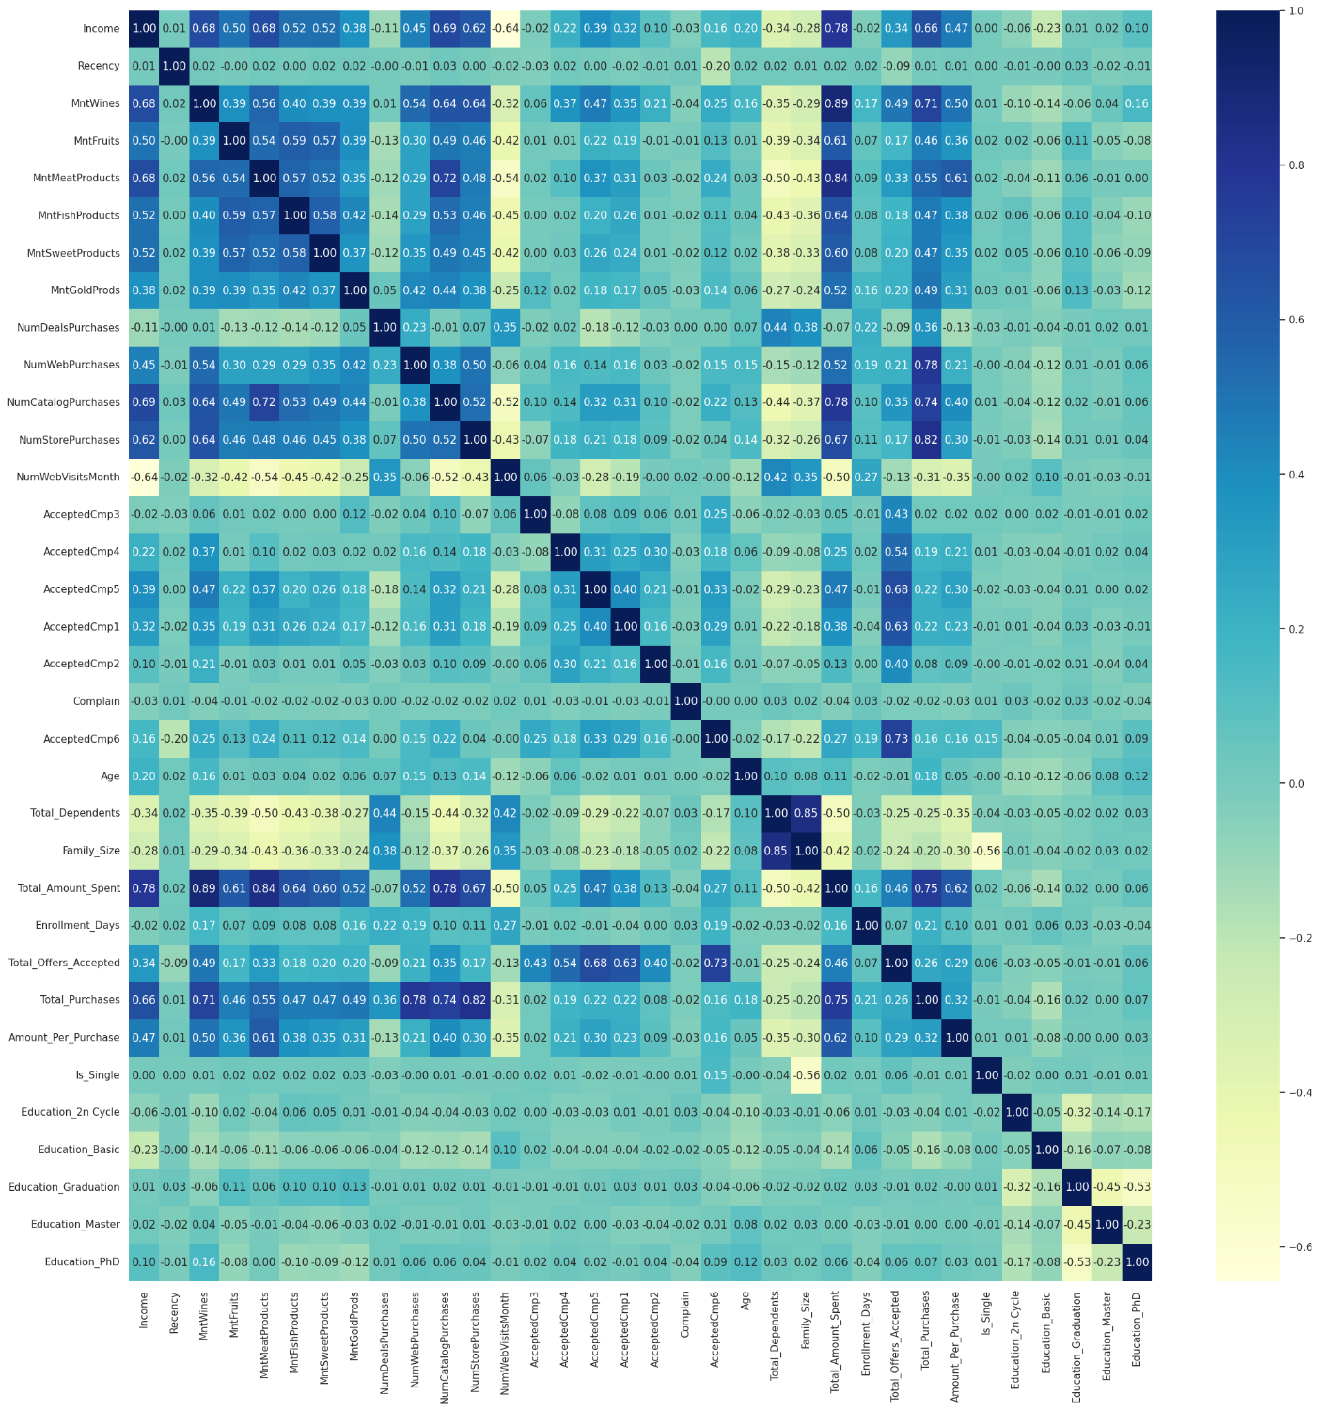

Appendix — Data preparation and feature engineering
Treatments applied
Marital status: 8 categories (incl. 'Alone', 'Absurd', 'YOLO') consolidated to Single vs Partnered
Income of $666,666 replaced with $136,016.42 — the mean of the other customers earning > $100k, with the suspect value itself excluded from the average
24 missing incomes imputed with $51,512.05 — the mean of customers earning < $100k (median $51,250, so the mean is not tail-distorted)
3 implausible birth years (1893, 1899, 1900) replaced with the median; oldest customer is now 76
'Response' renamed AcceptedCmp6; Education one-hot encoded; Is_Single flag created
Engineered features
Age · Total_Dependents · Family_Size · Enrollment_Days (tenure)
Total_Amount_Spent · Total_Purchases · Amount_Per_Purchase · Total_Offers_Accepted
25 behavioral features standardized (z-scores) for clustering; demographics kept as profiling attributes
Correlation heatmap after feature engineering. Income is the major driver of spending and campaign acceptance; households with more dependents spend less; longer-tenured customers spend more.
13
Notes:
Reference: data treatments and engineered features.

Slide 14
Appendix — Model comparison on the chosen metric
Algorithm | Clusters | Silhouette | Cluster sizes | Reading
K-Means | 2 | 0.308 | 913 / 1,327 | Best raw separation, but only "high vs low value"
K-Medoids | 2 | 0.242 | 1,237 / 1,003 | More balanced split; centers are real customers; weaker separation
Hierarchical (Ward) | 4 | 0.205 | 242 / 580 / 519 / 899 | Four actionable segments; lowest separation
GMM (hard labels) | 4 | 0.305 | 1,318 / 713 / 112 / 97 | Best 4-segment solution; nearly matches the K=2 optimum; soft assignments
DBSCAN (eps=4, min_samples=20) | 3 + noise | 0.221 | 1,725 / 74 / 107 + 334 noise | Outlier lens: 334 customers (15%) left unassigned
Silhouette computed on the standardized clustering features. DBSCAN scored on non-noise points; GMM on hard (most-probable) assignments. Source: model comparison table in the notebook.
0.308
0.305
0.205
K-Means, K=2 — highest score, coarse split
GMM, 4 components — chosen model
Hierarchical, 4 clusters — corroborates structure
14
Notes:
Reference: the quantitative model comparison table from the notebook.

Slide 15
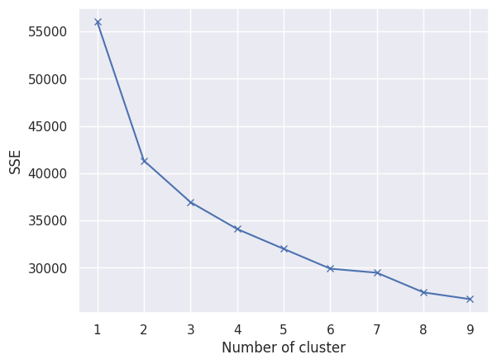
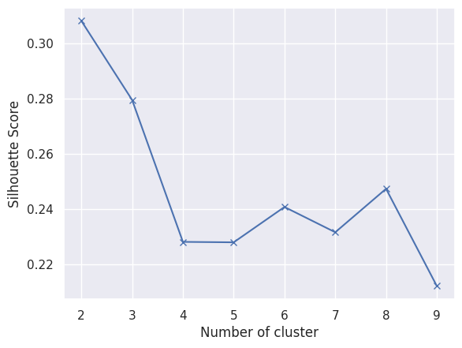
Appendix — Choosing the number of segments (K-Means)
Elbow method (within-cluster SSE)
Silhouette score by K
Steep drop to K=2, notable drops to K=3 and K=4, then the curve flattens — K=4 reads as the elbow.
Highest at K=2 (about 0.31), declining through K=3 (0.28) and K=4 (0.23).
When the two disagree, the data has no compact, well-separated clusters beyond a coarse high-value / low-value split — the K=4 partition cuts through denser regions. K=2 is used for K-Means; the 4-segment granularity marketing needs is pursued with hierarchical clustering and the Gaussian Mixture Model, and the trade-off is quantified in the model comparison.
15
Notes:
Reference: elbow and silhouette curves behind the K choice.

Slide 16
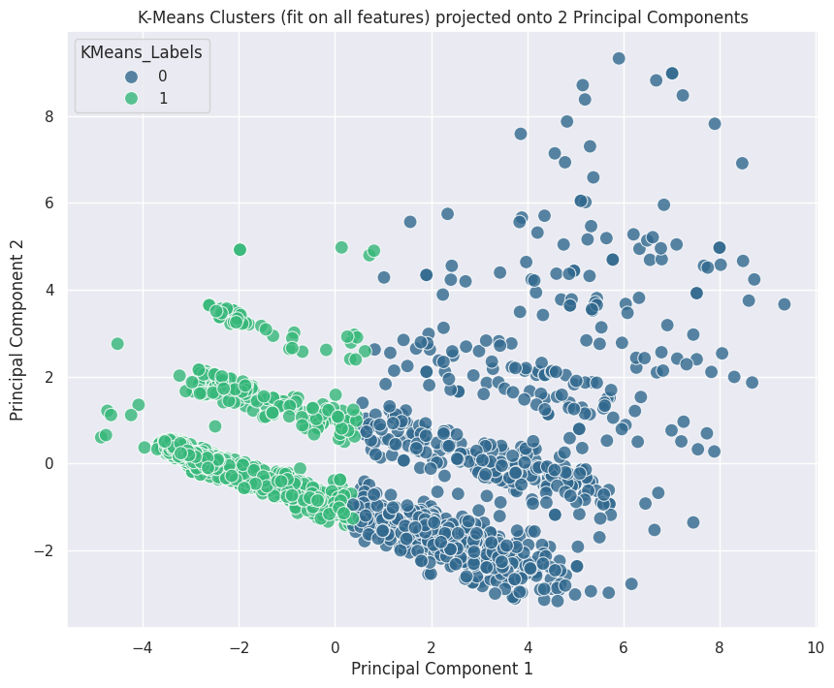
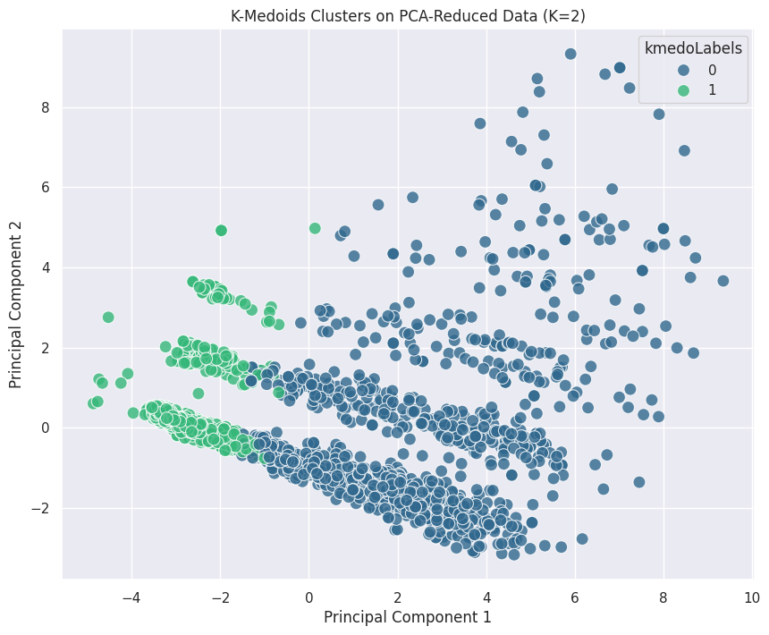
Appendix — K-Means and K-Medoids (K = 2)
K-Means (K=2) projected onto 2 principal components. Sizes 913 / 1,327; silhouette 0.308. Cluster 0: income about $71,100, total spend about $1,232; Cluster 1: income about $38,900, total spend about $175.
K-Medoids (K=2) projected onto 2 principal components. Sizes 1,237 / 1,003; silhouette 0.2418. Draws the boundary lower than K-Means — about 90 more customers in the higher-value cluster, a purer low cluster (median spend $62).
16
Notes:
Reference: the two K=2 partitioning solutions and their profiles.

Slide 17
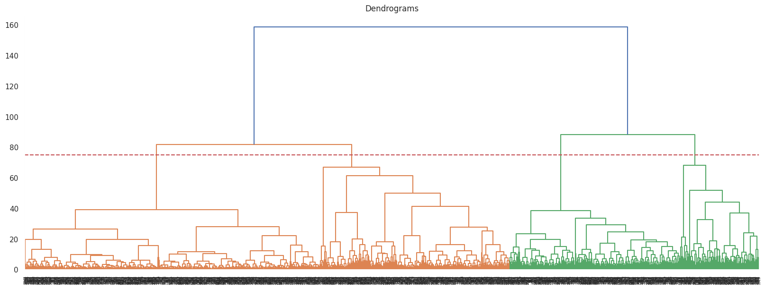
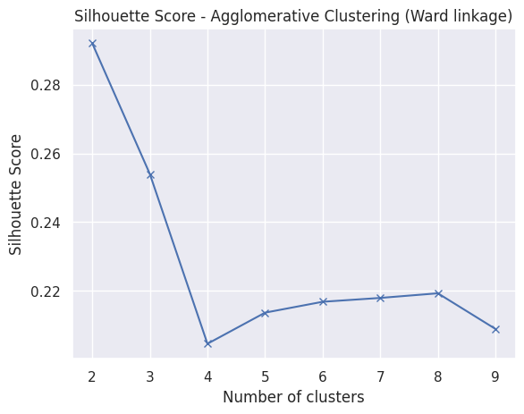
Appendix — Hierarchical clustering (Ward linkage)
Ward-linkage dendrogram with the cut at distance 75, giving 4 clusters of 899 / 580 / 519 / 242 customers.
Silhouette by number of clusters: peaks at 2 (0.29), 0.20 at 4.
Cophenetic correlation by linkage (Euclidean): single 0.8467 · average 0.8995 · complete 0.8214 · ward 0.5389
Average linkage preserves pairwise distances best but chains into unbalanced clusters; Ward optimizes within-cluster variance and produces the balanced, compact groups the problem needs. Its 4-cluster solution corroborates the GMM architecture: elite campaign responders (242), mid-market deal seekers (580), affluent quiet spenders (519), budget-conscious low spenders (899).
17
Notes:
Reference: hierarchical clustering diagnostics — dendrogram cut, silhouette sweep, cophenetic correlations, and the four Ward clusters that corroborate the GMM segments.

Slide 18
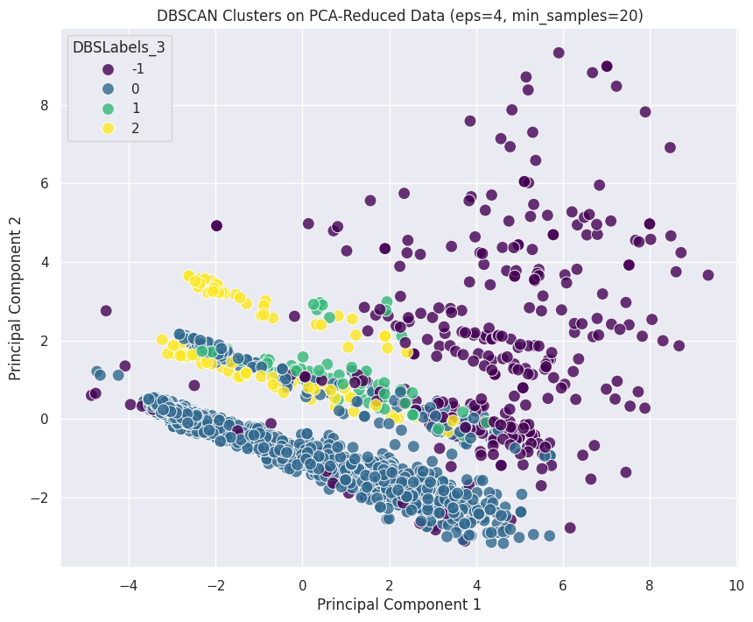
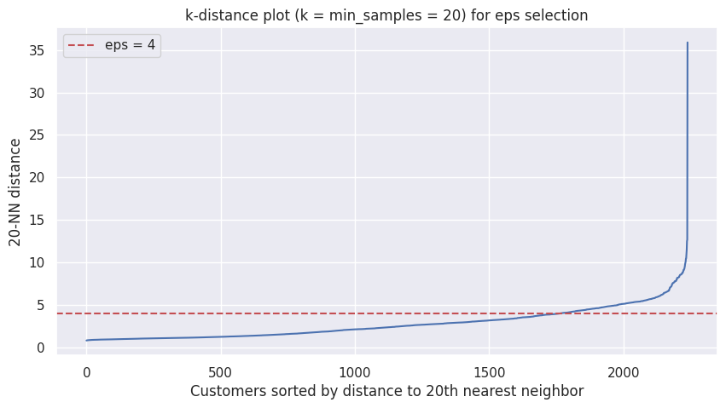
Appendix — DBSCAN tuning and result
k-distance plot (k = min_samples = 20): the curve bends in roughly the 4–6 range; about 90% of customers have a 20-NN distance below 5.2, so eps = 4 sits near the knee.
DBSCAN clusters (eps=4, min_samples=20) projected onto 2 principal components.
Grid search (eps 1–5 × min_samples 5/10/20): eps ≤ 2 discards 38–78% of customers as noise; eps = 5 collapses nearly everyone into one cluster (its silhouette of about 0.50 is an artifact of that triviality). eps = 4, min_samples = 20 gives 3 clusters plus 334 noise points (15%), silhouette 0.221 on clustered points. Cluster 1 (74 customers) is 100% campaign-4 acceptors and cluster 2 (107) is 100% campaign-3 acceptors — DBSCAN is used here as an outlier lens, not the segmentation of record.
18
Notes:
Reference: DBSCAN hyperparameter selection (k-distance plot and grid search) and why the result is treated as diagnostic rather than as the segmentation of record.

Slide 19
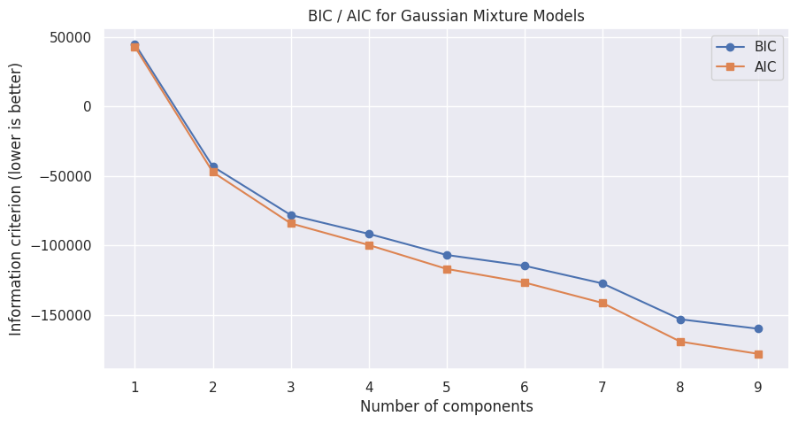
Appendix — GMM: choosing the number of components
How many components?
BIC and AIC decrease monotonically through 9 components with no interior minimum — the standardized binary campaign flags are not Gaussian, so the criteria cannot pick K alone. Four components were chosen for parsimony, consistency with the elbow and the 4-branch dendrogram, and interpretability.
Is the solution stable?
BIC / AIC across component counts (lower is better)
The fitting algorithm (EM) only finds local optima, so the model was fit from 15 random initializations. The solution with 1,318 / 713 / 112 / 97 customers recurred across seeds 9, 11, 14 and 15 at the best log-likelihood (26.771), with seed 6 nearly identical. Any solution with a component under 50 customers (about 2%) was screened out as a spurious maximum. Selected: random_state = 9. Full table on the next slide.
0.3047
silhouette on hard assignments — best of any 4-segment solution
GMM clusters projected onto 2 principal components (K=4)
19
Notes:
Reference: BIC/AIC evidence and the stability logic behind the four-component choice.

Slide 20
Appendix — GMM multi-start stability (15 initializations)
seed | cluster sizes | log-likelihood
1 | (1113, 845, 166, 116) | 22.863
2 | (997, 966, 151, 126) | 25.734
3 | (968, 940, 231, 101) | 25.752
4 | (998, 966, 178, 98) | 25.806
5 | (1000, 965, 199, 76) | 25.435
6 | (1318, 713, 109, 100) | 26.766
7 | (1110, 848, 166, 116) | 22.862
8 | (997, 966, 151, 126) | 25.734
9 | (1318, 713, 112, 97) | 26.771
10 | (1000, 965, 199, 76) | 25.435
11 | (1318, 713, 112, 97) | 26.771
12 | (1258, 710, 243, 29) | 21.139
13 | (1252, 650, 180, 158) | 25.235
14 | (1318, 713, 112, 97) | 26.771
15 | (1318, 713, 112, 97) | 26.771
Reading the table
15 initializations converged to several different solutions — the local-optima problem made visible.
The best-likelihood non-degenerate solution (26.771; sizes 1,318 / 713 / 112 / 97) recurs across seeds 9, 11, 14 and 15, with seed 6 nearly identical.
Seed 12 carved out a 29-customer component at a worse likelihood; separate experimentation showed rare runs reach higher likelihood via a 21-customer component — spurious maxima of unconstrained mixtures.
Rule applied: best log-likelihood among solutions whose smallest component has at least 50 customers (about 2%), ties broken by lowest seed → random_state = 9.
Adopted solution: silhouette 0.3047 on hard assignments.
20
Notes:
Reference: the multi-start stability table behind the final model selection.

Slide 21
Appendix — GMM segment profile (original units, segment means)
Attribute | C0 Deal-driven (112) | C1 Elite (97) | C2 Budget (1,318) | C3 Affluent (713) | Overall
Share of customers | 5.0% | 4.3% | 58.8% | 31.8% | 100%
Income | 52,220.96 | 80,170.00 | 39,425.67 | 71,384.69 | 52,002.48
MntWines | 459.19 | 847.13 | 108.87 | 566.23 | 303.94
MntMeatProducts | 86.56 | 375.11 | 41.40 | 383.34 | 166.95
Total_Amount_Spent | 625.64 | 1425.90 | 199.77 | 1241.67 | 605.80
Amount_Per_Purchase | 31.72 | 93.24 | 14.56 | 59.95 | 33.27
Total_Purchases | 17.98 | 18.89 | 10.63 | 21.65 | 14.86
NumDealsPurchases | 3.46 | 1.33 | 2.45 | 2.05 | 2.33
NumCatalogPurchases | 2.41 | 5.00 | 0.97 | 5.51 | 2.66
NumStorePurchases | 6.59 | 7.62 | 4.18 | 8.40 | 5.79
NumWebVisitsMonth | 6.52 | 4.16 | 6.22 | 3.62 | 5.32
Total_Offers_Accepted | 1.00 | 2.85 | 0.15 | 0.58 | 0.45
AcceptedCmp4 (rate) | 0.76 | 0.85 | 0.00 | 0.00 | 0.07
Complain (rate) | 0.18 | 0.01 | 0.00 | 0.00 | 0.01
Age | 50.76 | 47.55 | 45.90 | 48.68 | 47.10
Total_Dependents | 1.12 | 0.39 | 1.23 | 0.48 | 0.95
Source: original-units GMM profile table in the notebook (cluster means; demographic attributes were profiling-only and not used for clustering).
21
Notes:
Reference: selected rows of the original-units profile table for the final GMM segments.

Slide 22
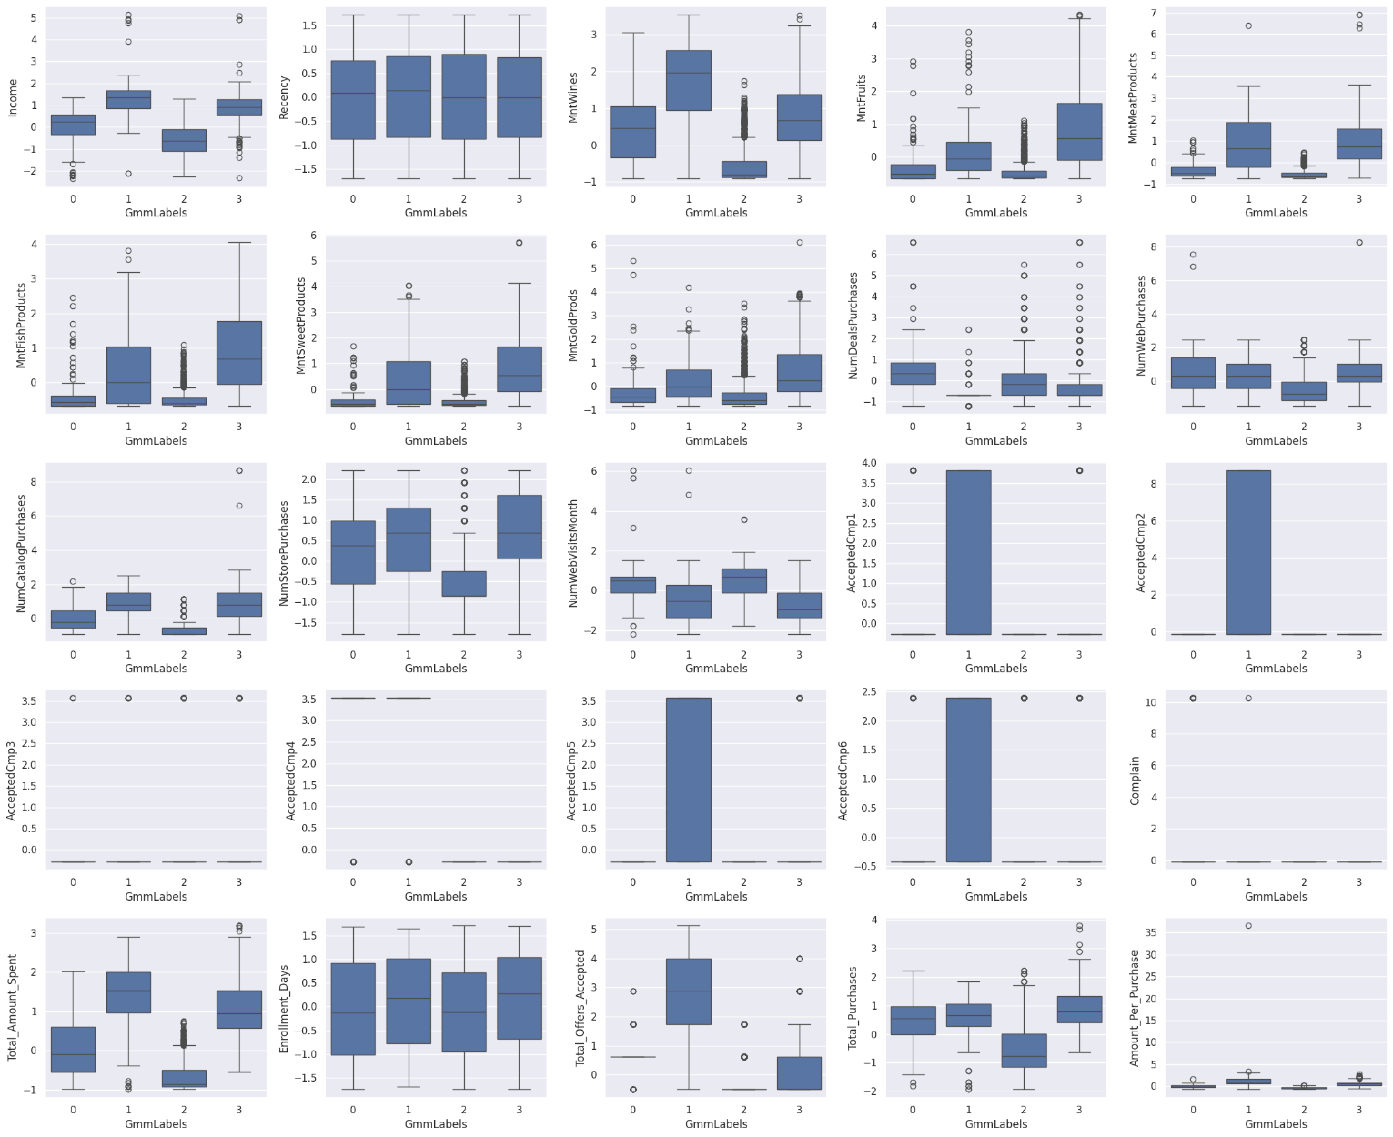
Appendix — GMM segment profiles across all 25 clustering features
Boxplots of each standardized clustering feature by GMM segment. For the two small responder segments (clusters 0 and 1), several campaign-acceptance flags render as full boxes rather than flat lines — the campaign-response signature that defines them.
22
Notes:
Reference: full-feature boxplot profile of the GMM segments.

